Slide 1

FocusNest – Modular Project Management System
Built for clarity, collaboration, and cinematic impact
Presented by Khem
2023

Slide 2

Problem Statement
Teams often face fragmented task flows, limited visibility across projects, and tools that lack emotional engagement, leading to frustration and inefficiency.
The goal is to create a system that feels intentional, expressive, and scalable, transforming project management into an inspiring experience.

Slide 3
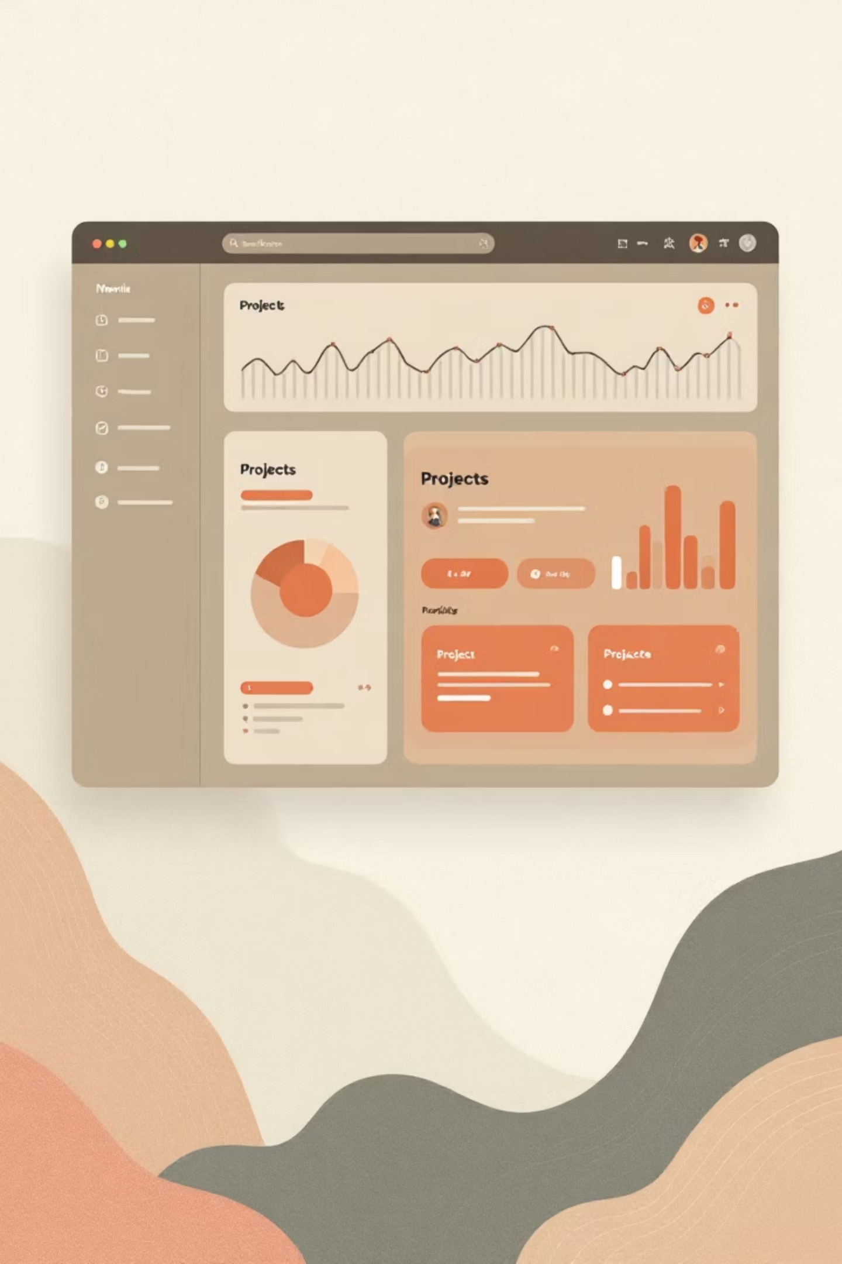
Solution Overview
FocusNest is a modular, secure project management system designed for clear user journeys, cinematic user experience, and scalable architecture.
It seamlessly combines form and function, delivering real impact through intuitive design and robust functionality that empowers teams to thrive.

Slide 4
Key Features
1
2
3
🔐 Secure Authentication
📁 Project Management
✅ Task Tracking
Streamlined login, registration, and logout flows with robust security to protect user data and ensure seamless access.
Effortless creation, viewing, and deletion of projects, enabling organised workflows from inception to completion.
Precise assignment and status monitoring of tasks, keeping teams aligned and progress transparent.
4
5
🎯 Personalised Dashboard
🧩 Modular Structure
Custom overview displaying key data, providing instant insights and tailored productivity tools.
Flexible routing and folder organisation for adaptable, future-proof system expansion.

Slide 5
Tech Stack
Layer
Tools Used
Frontend
HTML, CSS, Bootstrap, EJS for responsive, dynamic interfaces
Backend
Node.js, Express.js for efficient server-side logic and API handling
Database
SQLite for lightweight, reliable data storage and querying
Auth & Logic
bcrypt, express-session for secure password hashing and session management
Deployment
Local, Render, or Vercel for flexible hosting and scalability

Slide 6
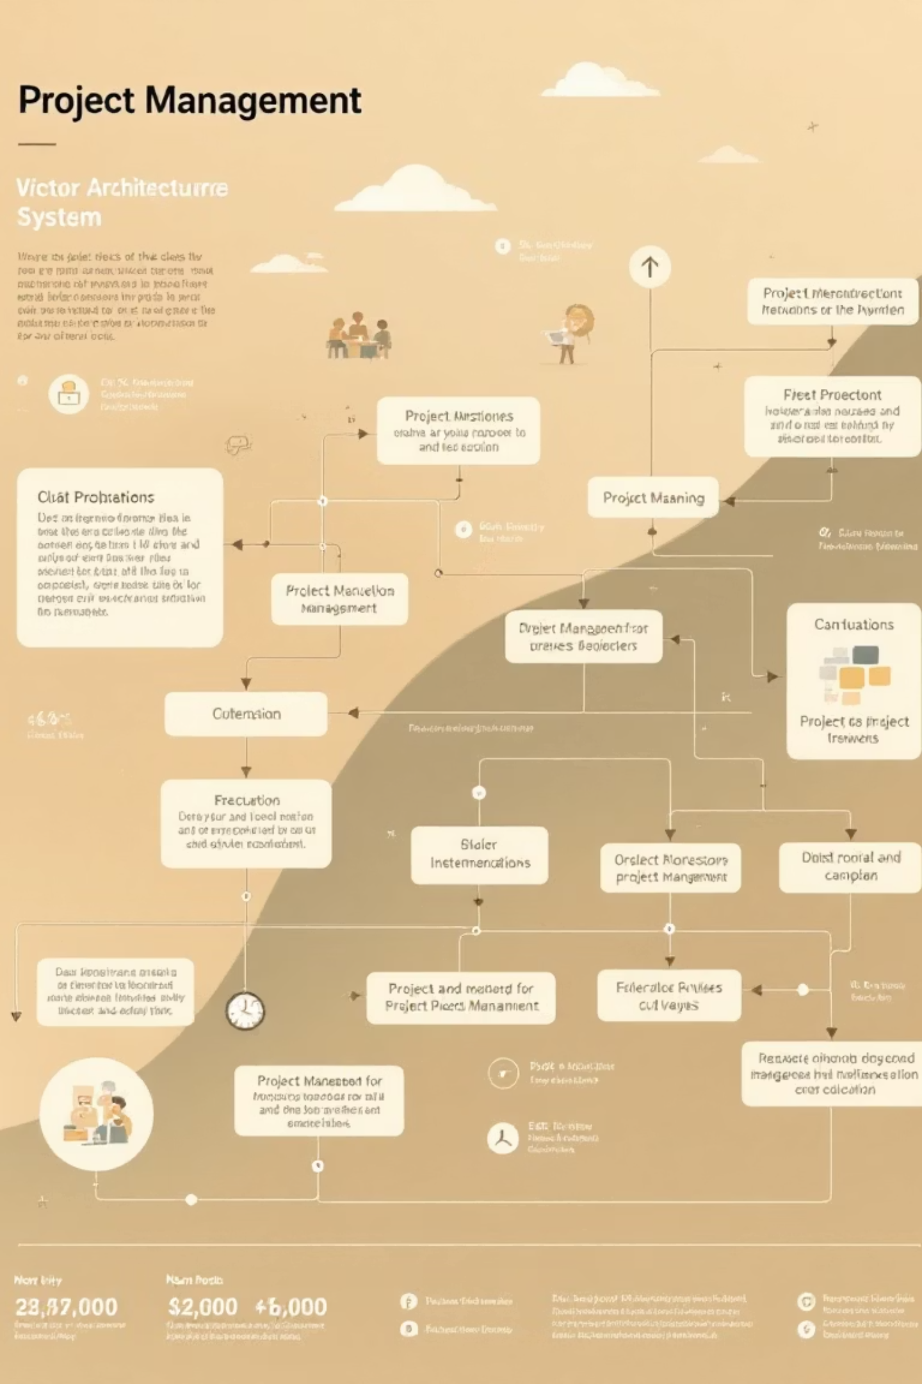
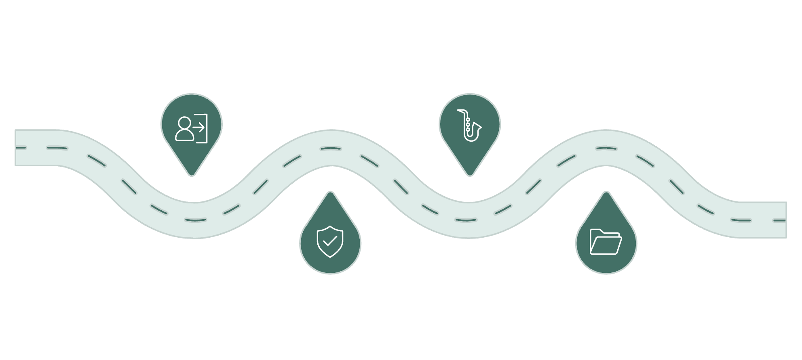




System Architecture
FocusNest follows a streamlined flow: User authenticates, accesses the dashboard, navigates to projects, and manages tasks with session-based controls.
User Login
Dashboard
Enter credentials to start session
Overview with secure session access
Authentication
Projects & Tasks
Validate identity and create token
Navigate /projects and /tasks routes
This modular design ensures clean separation of concerns, enhancing maintainability and performance.

Slide 7
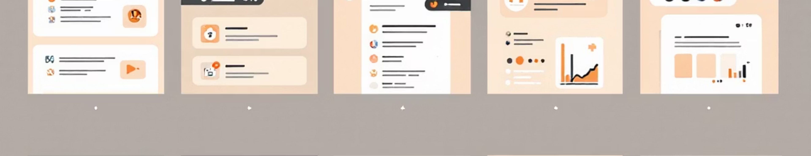
Demo Walkthrough
Core Journey
Key Highlights
Secure login to personalised dashboard
Smooth transitions between views create a fluid experience. Expressive feedback via branded alerts and modals keeps users engaged. Clean routing and modularity ensure reliability and ease of extension.
Create and organise new projects effortlessly
Add, assign, and track tasks with real-time updates
View and manage project details seamlessly

Slide 8





Challenges Overcome
Session Handling
Navigated complex session persistence and error feedback to maintain secure, uninterrupted user sessions across interactions.
Dynamic Routing
Implemented flexible EJS rendering for modular routes, ensuring smooth navigation without performance hits.
SQLite Debugging
Resolved intricate query issues through rigorous testing, guaranteeing data integrity and fast retrievals.
Modular Organisation
Structured folders for scalability, overcoming integration hurdles to support future enhancements seamlessly.

Slide 9
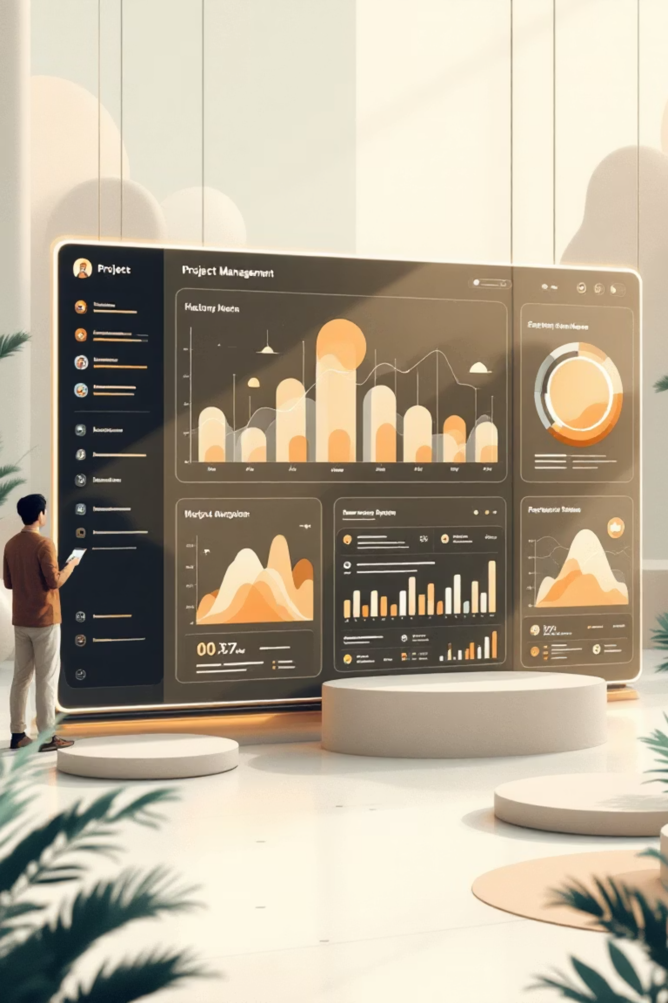

Future Vision and Next Steps
FocusNest sets the foundation for advanced features like AI-driven insights and collaborative real-time editing, ready for production scaling.
Next: Integrate cloud deployment, gather user feedback, and expand modularity. Let's collaborate to bring this vision to life—contact Khem for demos and discussions.
Ready for evaluation: Demo available upon request.

Slide 10




VibeCodersUnited
Our diverse team brings together specialized skills to deliver FocusNest from concept to presentation.
Rishav
Project Lead & Management
Khem
Backend Development
Rohit
UI/UX Design
Gurjit
UI/UX Design
Gettali
Presentation & Content

